Slide 1
Ethical Student Hackers
Password Cracking
Slides: shefesh.com/sessions

Slide 2
The Legal Bit
The skills taught in these sessions allow identification and exploitation of security vulnerabilities in systems. We strive to give you a place to practice legally, and can point you to other places to practice. These skills should not be used on systems where you do not have explicit permission from the owner of the system. It is VERY easy to end up in breach of relevant laws, and we can accept no responsibility for anything you do with the skills learnt here.
If we have reason to believe that you are utilising these skills against systems where you are not authorised you will be banned from our events, and if necessary the relevant authorities will be alerted.
Remember, if you have any doubts as to if something is legal or authorised, just don't do it until you are able to confirm you are allowed to.
Relevant UK Law: https://www.legislation.gov.uk/ukpga/1990/18/contents

Slide 3
Code of Conduct
Before proceeding past this point you must read and agree to our Code of Conduct - this is a requirement from the University for us to operate as a society.
If you have any doubts or need anything clarified, please ask a member of the committee.
Breaching the Code of Conduct = immediate ejection and further consequences.
Code of Conduct can be found at https://shefesh.com/conduct

Slide 4
How are passwords stored?
The password you provide is inputted into a hashing algorithm.
There are various hashing algorithms, for example, MD5
The input of “frog” (the pre-image) to the MD5 algorithm produces this hash:
938c2cc0dcc05f2b68c4287040cfcf71
The hash is then stored on a server.
When you type your password into a website, it is put through the same hash algorithm, then the hashes are compared.

Slide 5
What makes hashing secure?
Mostly, one unique input = one unique fixed-length output
Frog will always hash to 938c2cc0dcc05f2b68c4287040cfcf71
when using the MD5 algorithm.
The pre-image cannot feasibly be worked out from the output of the algorithm. This is called the pre-image resistance strength.
Forget password cannot show you your password

Slide 6
Potential Issues with Hashing
Collisions:
where two pre-images (inputs) match to the same image(output)
MD5 is prone to collisions and is the main reason why it is no longer used.
Brute force attack:
You could try many common passwords to see if any work. This is a valid attack method due to human error/complacency.

Slide 7
Cracking a Hash
Brute force – run all possible combinations
Dictionary attacks – run all common combinations
Hash Table – key-value pairs for passwords and their associated hash, for a particular hashing algorithm
Rainbow table – in the end a slower version of a hash table, but significantly less storage space requirements
(want to know more? This is a good starting point: https://security.stackexchange.com/questions/92865/what-is-the-difference-between-a-hash-table-and-a-rainbow-table-and-how-are-the )

Slide 8
Cracking in Practice
Hashcat is a password cracker. The command below will crack a hash.
hashcat -m 0 -a 0 <your hash> /usr/share/wordlists/rockyou.txt
hashcat – the main command for running hashcat
-m 0 – the ‘-m’ denotes the hash algorithm, 0 is evaluated to be MD5
-a 0 – the ‘-a’ denotes the type of attack, 0 is evaluated to be a dictionary attack
<your hash> -- the hash that you want to crack
/usr/share/wordlists/rockyou.txt – the absolute path for the dictionary that is pre-installed on many linux distros.

Slide 9
Practice Cracking
Cracking is most easily done on Linux, as hashcat and rockyou.txt are already installed.
With that in mind,
https://tryhackme.com/r/room/crackthehash
Try hack me uses a virtual box that runs the Ubuntu distro of linux
You will need to create an account if you don’t already have one, then click on start attackbox.
Once running hashcat command, type s (and press enter) to get status info

Slide 10
Using TryHackMe
Once the attackbox has loaded. You will be greeted with a terminal. Press enter to close the terminal and you will see a GUI. Double click the terminal shortcut to open a blank terminal. Run hashcat from there.
Copy and pasting:
Crtl-Shift-C/V
May need to enable copy and paste in the browser.

Slide 11
Working through No.4
awk -b 'length == 4' /usr/share/wordlists/rockyou.txt > new.txt
This creates a new file (new.txt) with all the passwords of length equal to 4. This is put wherever your active directory is.

Slide 12
Protecting against attacks - salt
A salt is a random string of characters. This is added to each password before it is hashed.
This protects against brute force attacks as each password now has a random element to it, thus hash and rainbow tables cannot be generated to match them.
You can prepend or append a salt to a password

Slide 13
Protecting against attacks - pepper
A ‘pepper’ is the same as a salt, but not unique for each password.
A website would use the same random string for each password.
A pepper is not stored with the passwords, so is kept secret so if a password is salted and peppered, it cannot be cracked without knowing the pepper

Slide 14
Salt and Pepper Examples
Base: frog = 938c2cc0dcc05f2b68c4287040cfcf71
Salted: frog = 585f85938c2cc0dcc05f2b68c4287040cfcf71
Peppered:
frog = 598t5g938c2cc0dcc05f2b68c4287040cfcf71
Salt and Peppered:
robot = 598t5g87b7cb79481f317bde90c116cf36084b47df5df

Slide 15
Protecting against attacks - speed
Most algorithms are designed to be fast. Usually as fast as possible.
Hashing is different, as brute force attacks are the only feasible way of cracking a password.
So hashing algorithms are designed to be slow.

Slide 16
Why being slow matters
Salting completely cancels out hash and rainbow tables, along with any other pre-computed tables of hashes.
This means the only attack method is computing a hash ‘at runtime’.
Therefore, by having a slow algorithm it takes a very long time for a human/robot to try hundreds or thousands of passwords

Slide 17
Extra Reading/Support
Really good explanation of hashing and reasons for needing salt: https://auth0.com/blog/adding-salt-to-hashing-a-better-way-to-store-passwords/
A List of hashing algorithms and codes for hashcat
https://hashcat.net/wiki/doku.php?id=example_hashes

Slide 18
Cracking in practice
Hashcat is a password cracker. The command below will crack a salted hash
hashcat -m 0 -a 0 <your hash>:<your salt> /usr/share/wordlists/rockyou.txt
hashcat – the main command for running hashcat
-m 0 – the ‘-m’ denotes the hash algorithm, 0 is evaluated to be MD5
-a 0 – the ‘-a’ denotes the type of attack, 0 is evaluated to be a dictionary attack
<your hash> -- the hash that you want to crack
/usr/share/wordlists/rockyou.txt – the absolute path for the dictionary that is pre-installed on many linux distros.

Slide 19
Practice Cracking
Cracking is most easily done on Linux, as hashcat and rockyou.txt are already installed
With that in mind,
https://tryhackme.com/r/room/crackthehash
Try hack me uses a virtual box that runs the Ubuntu distro of linux
You will need to create an account if you don’t already have one, then click on start attackbox.
Once running hashcat command, type s to get status info

Slide 20
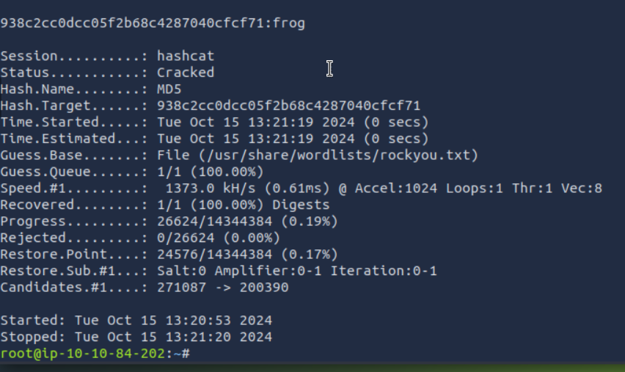
Understanding hashcat
At the top is the hash, then the password it matches.
Status - cracked or running, show if its doing anything
Time.estimated - shows how long it may take - if this is greater than 20 mins then Crtl-C to stop hashcat, you have chosen an incorrect mode or attack method.

Slide 21
Upcoming Sessions
28th October: Enumeration
What’s up next?
www.shefesh.com/sessions

Slide 22

Any Questions?
www.shefesh.com
Thanks for coming!

